Slide 1
(a)
(b)

Slide 2
(a)
(b)

Slide 3
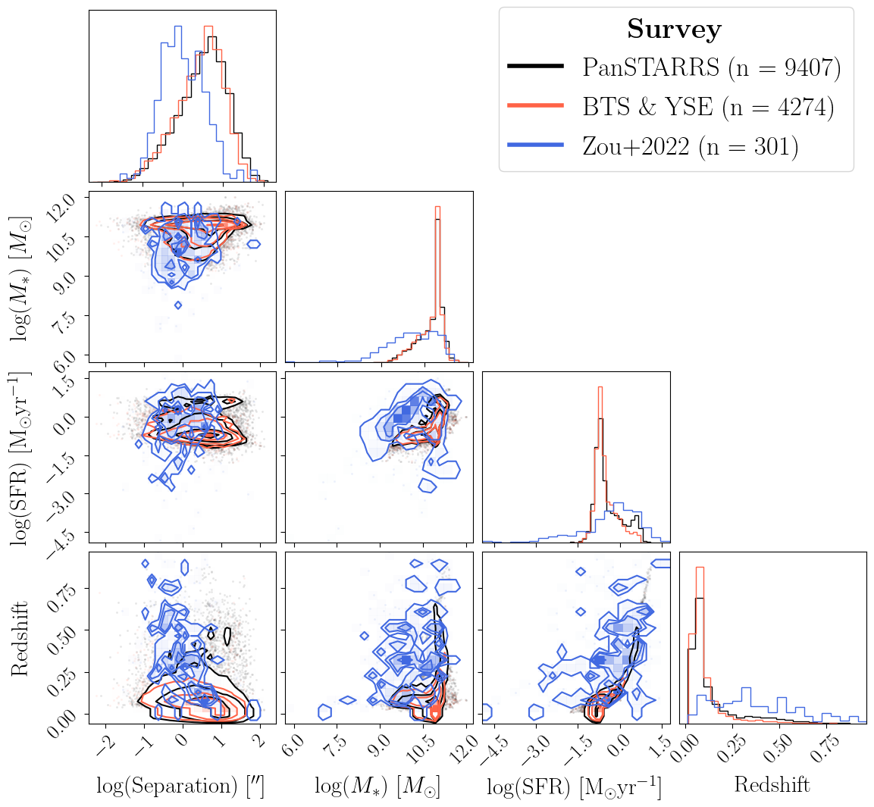
(a)
(b)

